Slide 1
PBS Training
Prepared by the
Envoy/AFA
Joint PBS Committee
Notes:
Changed word order

Slide 2
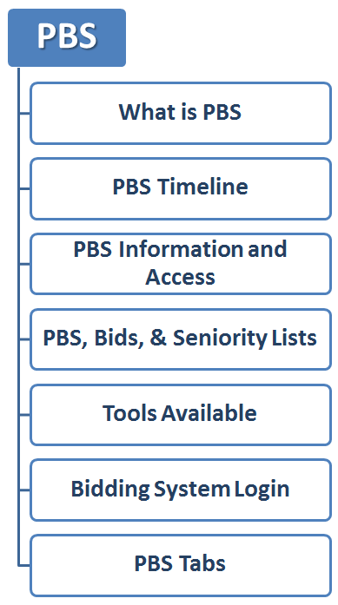
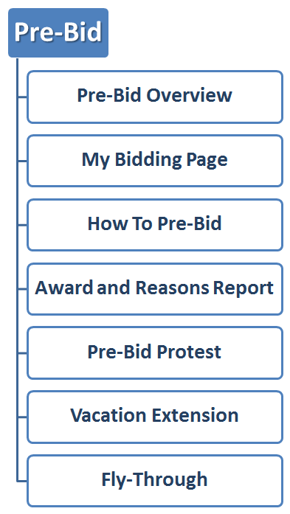
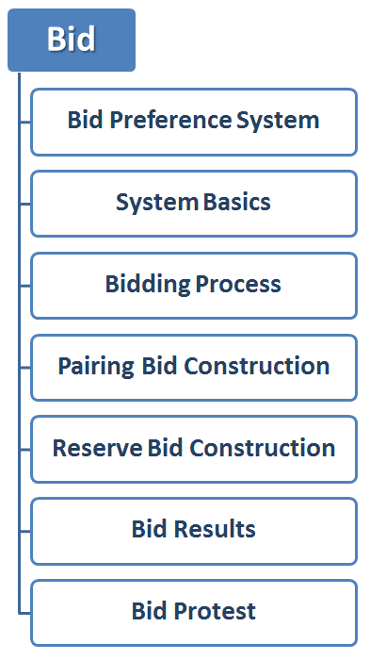
PBS Training Overview
Section 1
Section 2
Section 3

Slide 3

Section 1
Welcome to PBS
  What is PBS
  PBS Timeline
  PBS Information and Access
  PBS, Bids, & Seniority Lists
  Tools Available
    Bid Packets
    PBS Target Information
  Bidding System Login
  PBS Tabs

Slide 4
What is PBS?
PBS stands for Preferential Bidding System.
Envoy bidding happens in two different phases:
  Pre-Bid
  Bid
NAVBLUE runs the web-based software that builds your individual monthly schedule, known as the Bid Preference System and/or PBS Scheduler.
Schedule construction is based on your preferences, including both likes and dislikes for flying, specific pairings, and days off. The awards are in seniority order.

Slide 5
PBS Timeline
The monthly bidding timeline is as follows:
  Pre-Bid period opens on the 10th at noon and closes on the 13th at noon.*
  Pre-Bid Awards are posted by the 14th at noon.*
  Pre-Bid protest period opens on the 14th at noon and closes on the 15th at noon.*
  Vacation extension and fly-through requests open on the 10th at noon and close on the 20th at noon.*
  Vacation slide request opens on the 15th at noon and closes on the 20th at noon.*
  Bid opens on the 15th at noon and closes on the 20th at noon.*
  Preliminary Awards are posted 22nd at noon.*
  Bid protest period opens on the 22nd at noon and closes on the 23rd at noon.*
  Awards will be final on the 24th at noon.*
  *Central Time

Slide 6
PBS Timeline
 | 10th | 13th | 14th | 15th | 20th | 22nd | 23rd | 24th
Bidding Availability | Pre-Bid Opens at noon CT | Pre-Bid Closes at noon CT |  | Bid Opens at noon CT | Bid Closes at noon CT
VG and Fly Through | Opens at noon CT |  |  |  | Closes at noon CT
Vacation Slide Request |  |  |  | Opens at noon CT | Closes at noon CT
Results Publishing |  |  | Preliminary Pre-Bid Awards Posted by noon CT | Pre-Bid Awards Finalized at noon CT |  | Preliminary Awards Posted at noon CT |  | Bid Awards Finalized at noon CT
Protest Period |  |  | Pre-Bid Protest Opens at noon CT | Pre-Bid Protest Closes at noon CT |  | Bid Protest Opens at noon CT | Bid Protest Closes at noon CT

Slide 7

PBS Information and Access
Log into https://www.myenvoyair.com
Go to Departments
Click Flight Service
Click PBS, Bidding, & Seniority Lists

Slide 8
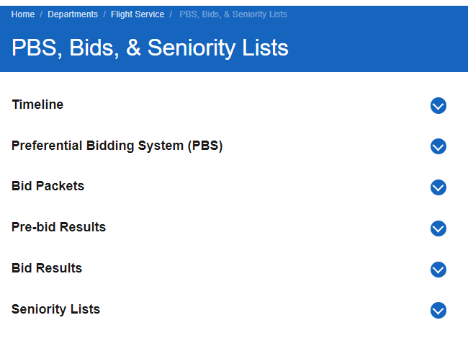
PBS, Bids & Seniority Lists
Bid Packets
Each bid packet contains: Bid Timeline, RBLs, RWOs, CDOs, Standby shifts, RAPs, transition trips, and all bid month pairings.
Seniority Lists
Base seniority lists; this information is updated every month on the 15th.
Company Seniority List
This seniority list includes all FAs and is updated twice a year (January and July).

Slide 9
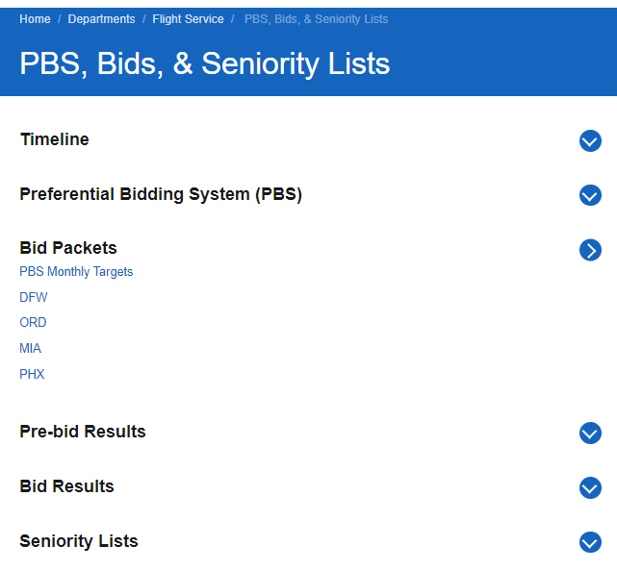
PBS, Bids & Seniority Lists
PBS Monthly Targets
Company targets for the upcoming bid month. This will show the number of each pre-bid option available. From here you can get an idea of how many lineholders and reserves are expected. By the 15th the Company will update the 5% Minimum credit to be awarded.
Preferential Bidding System (PBS)
PBS System Login, news, inquiries, and resources.
Pre-Bid & Bid Results
Results for each base. The Pre-Bid awards are posted on the 14th and the Bid Results on the 22nd of each month.

Slide 10
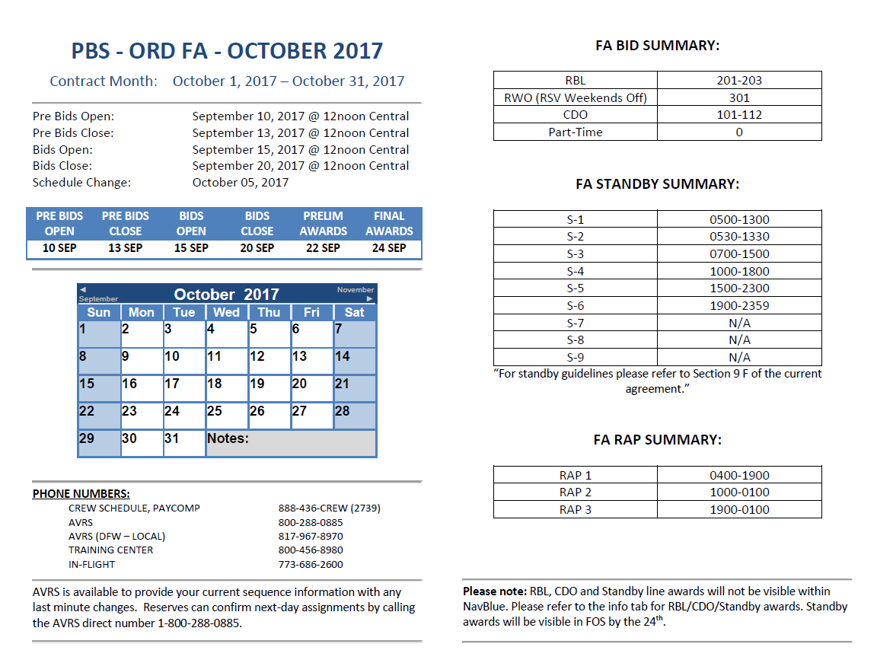
Tools Available
Bid Packets
Timeline – contains contractual month dates, Pre-Bid and Bid dates and times.
Schedule Change – Airline Schedule changes occur on this date (departure/arrival times, frequency, equipment, flight number, etc.)
Monthly Calendar – not a contractual calendar!
Phone Numbers – Crew Schedule, AVRS, and other important phone numbers.
FA Bid Summary – Lists lines available for Pre-bidding.
FA Standby Summary – Lists the standby shifts available for pre-bidding.
FA Rap Summary – Lists reserve availability periods for the bid month.
5
1, 2
6
3
7
4

Slide 11
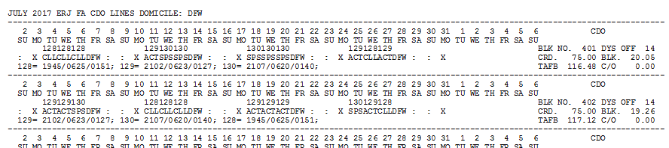
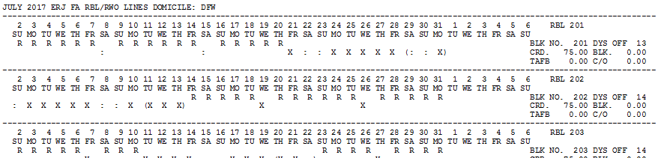
Tools Available
Bid Packets
CDO Lines – Displays the CDO lines available to pre-bid.
Line number used to pre-bid
RBL & RWO – Displays RBL and RWO lines available to pre-bid.
R RSV day | : Weekend day off | X Weekday off

Slide 12
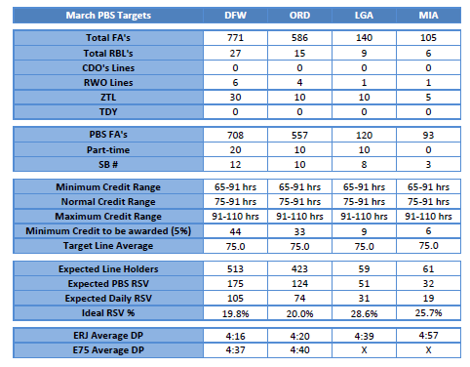
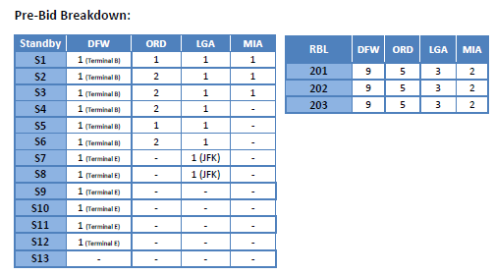
Tools Available
PBS Target Information
Target Information – Shows per base what is available to pre-bid.
Total number of RBL lines available
Total number of RWO lines available
Total number of Standby lines available
Total number of CDO lines available
RBL and Standby Breakdown – The number of each line to be awarded per Base.
* June is used as an example

Slide 13
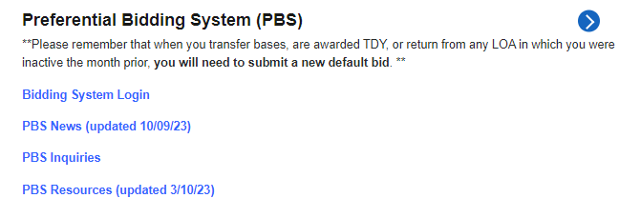
Bidding System Login
Once you are in PBS, Bids & Seniority Lists:
  Click on Bidding System Login
Notes:
Added arrow to the box

Slide 14
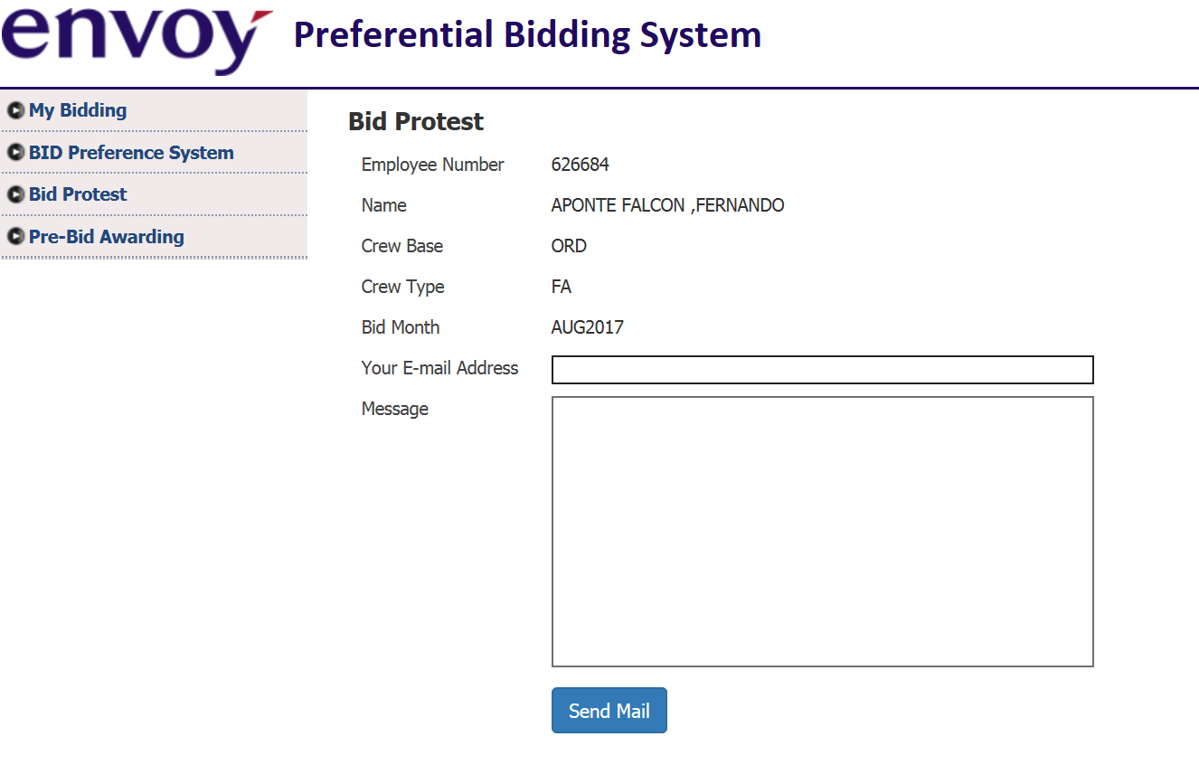
PBS Tabs
  My Bidding is the page used to enter pre-bid and vacation extension/fly-through requests.
  BID Preference System is a link to the Bid System “NAVBLUE.”
  Bid Protest is the page used to submit bid protests.
  Pre-Bid Awarding is the page that shows an individual’s pre-bid result and reasons report.

Slide 15
Section 2 - 1
Pre-Bidding
  Pre-Bid Overview
  My Bidding Page
  How to Pre-Bid
  Award and Reasons Report
  Pre-Bid Protest

Slide 16
Pre-bid Overview
What is Pre-bid?
Pre-bid is where you bid for Reserve Block Line (RBL), Reserve Weekends Off (RWO), Continuous Duty Overnight (CDO), Standby status, Zero Time Line (ZTL), and Part-Time status.
Things to Remember when Pre-bidding
RBL, RWO, and CDO (if available) lines are pre-built. You can view these lines in the bid packet.
Standby shifts are listed in the bid packet.
Any Standby bid(s) will be read only if you have not received a CDO, RBL, RWO, or Part-Time status.
If you are awarded Standby or Part Time, you will only be awarded the status. Between the 15th and 20th (noon Central Time) of the bid period, you must enter a NAVBLUE Bid in order to have your line completed.
To maintain your Standby status, you must be awarded a Reserve Line.
To maintain your Part-Time status, you must be awarded a Pairing Line.
Notes:
Added ZTL to list of availability

Slide 17
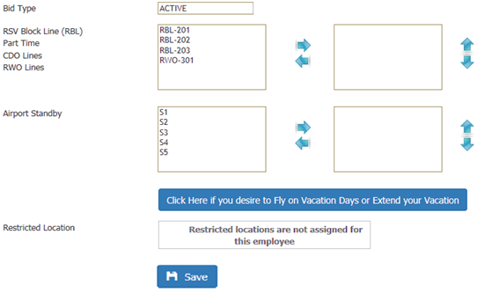
My Bidding Page
Your Pre-Bid Selections
Options Available to Pre-Bid
Change the Preference order
Submit the Pre-Bid Request
Add or Remove a Pre-Bid selection

Slide 18


How to Pre-Bid
Click to highlight the option you want to request from the box on the left.
Click the right-pointing arrow to move the option to the box on the right.
Repeat the process until you have moved all your preferences to the boxes on the right (you can request as many options as you want). The options will be listed within the box in the same order you move them.
If you wish to change the order, click to highlight the option and click the UP or DOWN arrow to move within the box.

Slide 19

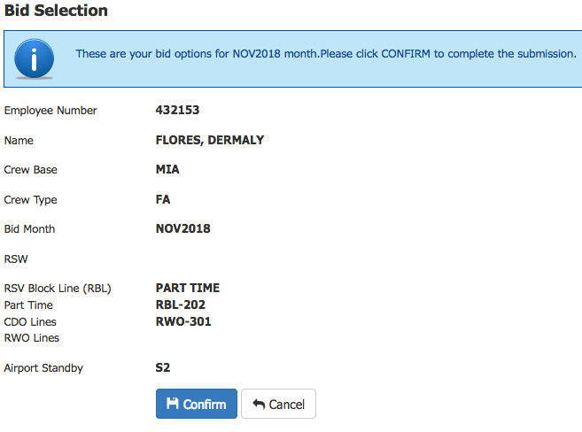
How to Pre-Bid
To remove an option, highlight the option and then click the left-pointing arrow to move the option to the box on the left.
Click Save to Preview your Pre-Bid selection(s).
Click Confirm to submit a request or Cancel to edit your request.

Slide 20
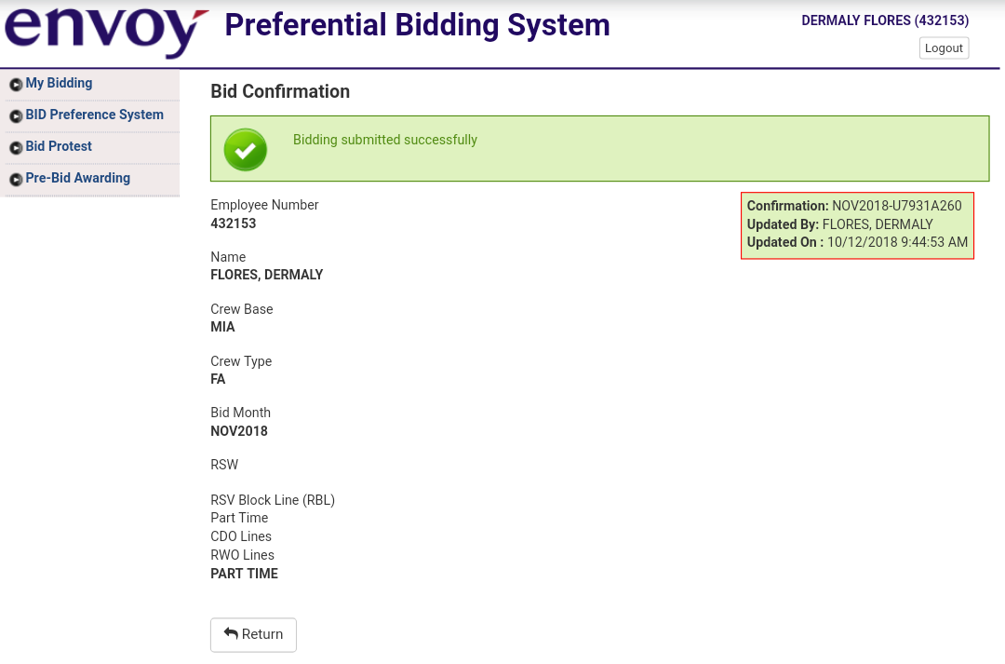
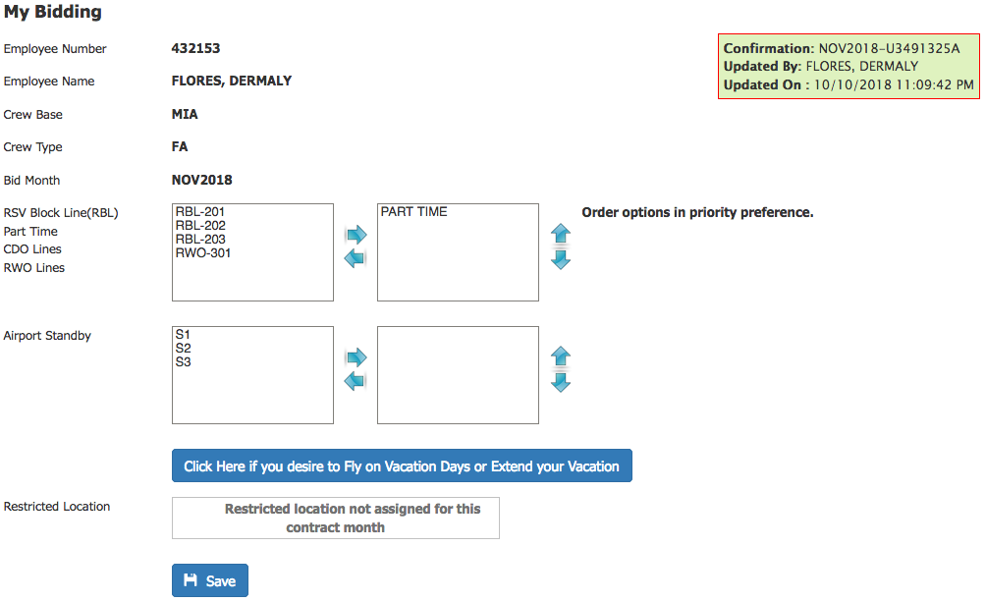
Pre-Bid Confirmation
A confirmation number should be displayed validating your submission. To leave this page you can click Return or choose a different tab.

Slide 21
Pre-Bid Confirmation
What to do if you don’t have a confirmation number
  Log off PBS, log back in, and go to My Bidding tab.
  Check for a confirmation number (green box right side of the page).
  Do you see a confirmation number and your submission?
    If yes, no additional action is needed.
    If you don’t see a confirmation but you see your submission(s): Email a JPBSC personnel your employee number and a screenshot of My Bidding tab.
    If both are missing: repeat the pre-bidding steps 1 to 7. If the problem persists, contact a JPBSC personnel providing your employee information, your pre-bid selection in order from first to last, and a detailed recap of the problem.
Note: All emails concerning Pre-Bid glitches must be sent before the 13th at noon central time. Emails will NOT be honored if missing required information or sent outside of the timeline.

Slide 22
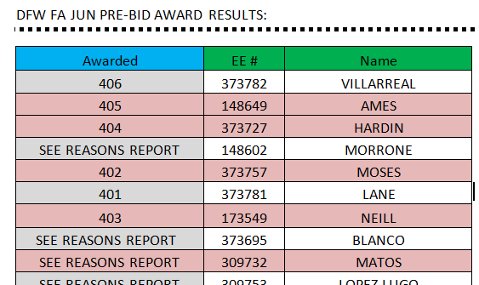
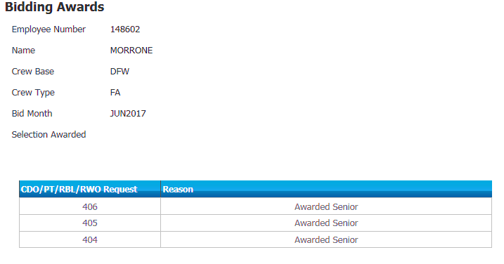
Award and Reasons Report
The Pre-Bid results will be published to MyEnvoy no later than the 14th at noon central time.
Use the Pre-Bid Awarding Tab in the Preferential Bidding System to view your detailed reasons report.
* CDO, RBL/RWO, and Standby line awards will not be visible within NAVBLUE (Bid Preference System).
* CDO, RBL/RWO, and Standby Awards will be visible in FOS by the 24th.

Slide 23
Pre-Bid Protest
Click the Bid Protest tab.
Enter your email address*
Type your message
Click “Send Mail”
          * Bid Protest responses will be sent to the email address you provide.

Slide 24
Section 2 - 2
Vacation and Pre-Bidding
  Vacation Extension & Fly-Through Timeline
  VG - Vacation Extension
  Selecting Vacation Extension Days
  Changing or Removing Vacation Extension Day(s)
  Vacation Extension & Slide
  Vacation Extension Dos & Don’ts
  My Bidding vs. RF 200 SLID
  Vacation Fly-Through
  Vacation Fly-Through Notes

Slide 25
VG - Vacation Extension
A Flight Attendant who is scheduled for a block of consecutive vacation days may elect to place up to a total of four (4) days off (at the sole discretion of the Flight Attendant) before, after, or split on either side of the vacation period. FAs with two or more continuous block(s) of vacation can extend their vacation block(s) to up to 8 days, but no more than 4 days at each end of their vacation period. If the FA request exceeds the above-mentioned allotment, all vacation extension dates will be removed and not honored.
The days off will act as pre-planned absences and will carry neither a value for pay nor credit. Each extension day (VG) will reduce the number of hours needed for line completion by 3:45.
These days must be continuous and adjacent to the vacation block you want to extend.
Vacation Extension Days may not appear in the NAVBLUE calendar until the 20th after noon central time.
Only FAs that received a Pre-Bid Line Awarded and that are wanting to slide vacation should submit a VG request through the HI6 Slid.
Notes:
Changed verbiage on third bullet point

Slide 26
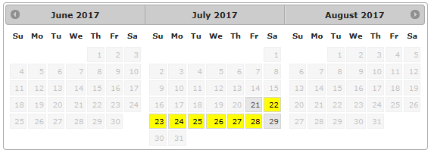
Selecting Vacation Extension Days
Go to “My Bidding”
Click the Blue Action Bar:
3 calendars will appear if you have vacation scheduled within the current month, bid month, and/or next month. Vacation days will be highlighted in yellow.
The following message will appear if you don’t have vacation planned during the 3 calendar months (Current, Bid and Next): “No vacation available for this contract month”
1 Current Month
2 Bid Month
3 Next Month
1
2
3
Vacation Days

Slide 27
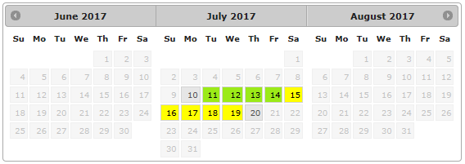
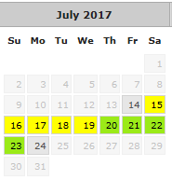
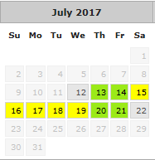
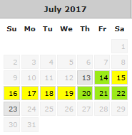
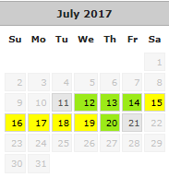
Selecting Vacation Extension Days
Click the desired days to extend your vacation.
You may select up to 4 days for each block of vacation using any combination:
Vacation Days
Vacation Extension

Slide 28
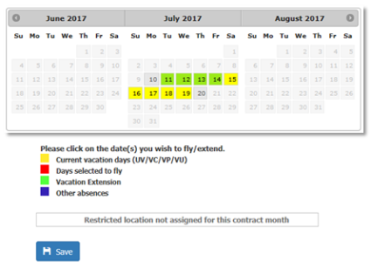

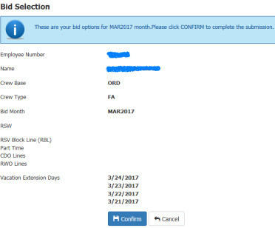


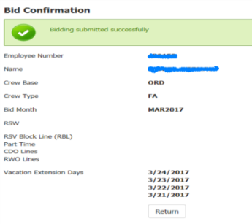
Selecting Vacation Extension Days
Click . A new screen will open with your “Bid Selection.”
Review your “Bid Selection” and click to submit your request. Or, click to go back and make changes.
Once you click , you will get a “Bid Confirmation” that will list the days that were extended.

Slide 29
Changing or Removing Vacation Extension Day(s)
Go back to “My Bidding”
Click the Blue Action Bar:
  To Remove your VGs: Click on the green highlighted squares, they will turn white, indicating you removed the previous selection.
  To Change your VGs: Click on the green highlighted squares, they will turn white, indicating you removed the previous selection. Select the new extension dates.
Click .

Slide 30
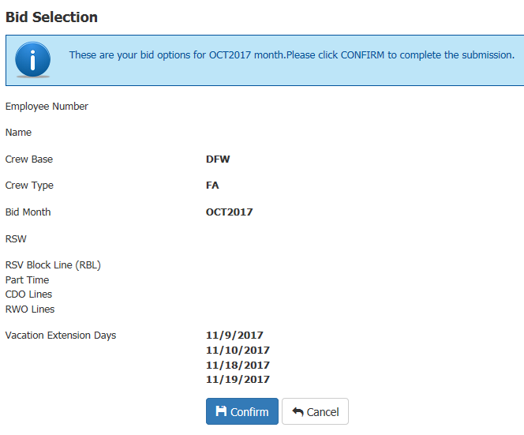
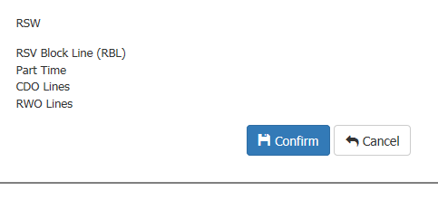
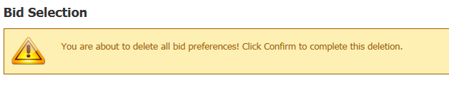

Changing or Removing Vacation Extension Day(s)
The “Bid Selection” page will appear with your changes. If you made changes the revised days will show. If you removed everything your new bid will be blank. Click .
A warning will appear advising that you are changing your bid preferences. If you want to proceed with your change(s) click .
You will see a new “Bid Confirmation”.

Slide 31
Vacation Extension (VG) Notice
Flight Attendants may select up to 4 vacation extension dates per vacation block but no more than 8 for those with more than one consecutive vacation block.
Additionally, no more than 4 vacation extension dates may be selected in either direction. If request exceed the above-mentioned allotment, all VGs will be removed.
You may only select VGs on days pertaining to the bid month, and up to the 5th of the next bid month. If selected outside of the bid month, those dates will be removed.

Slide 32
Vacation Slide
A Flight Attendant awarded a CDO, RWO, or RBL line may slide their vacation block in accordance with the following:
      Vacation block may be slid to start no more than four (4) days earlier or no more than four (4) days later than the originally scheduled vacation block.
      Consecutive vacation weeks are considered one block for the purpose of sliding a vacation.
      Consecutive CDO pairings shall be considered one “block” or “Pairing” for the purposes of sliding a vacation.
      Reserve Flight Attendant to use vacation slide procedure, the Flight Attendant must have a conflict with the reserve availability that is scheduled immediately prior to or after the vacation block that she/he wishes to rectify.

Slide 33
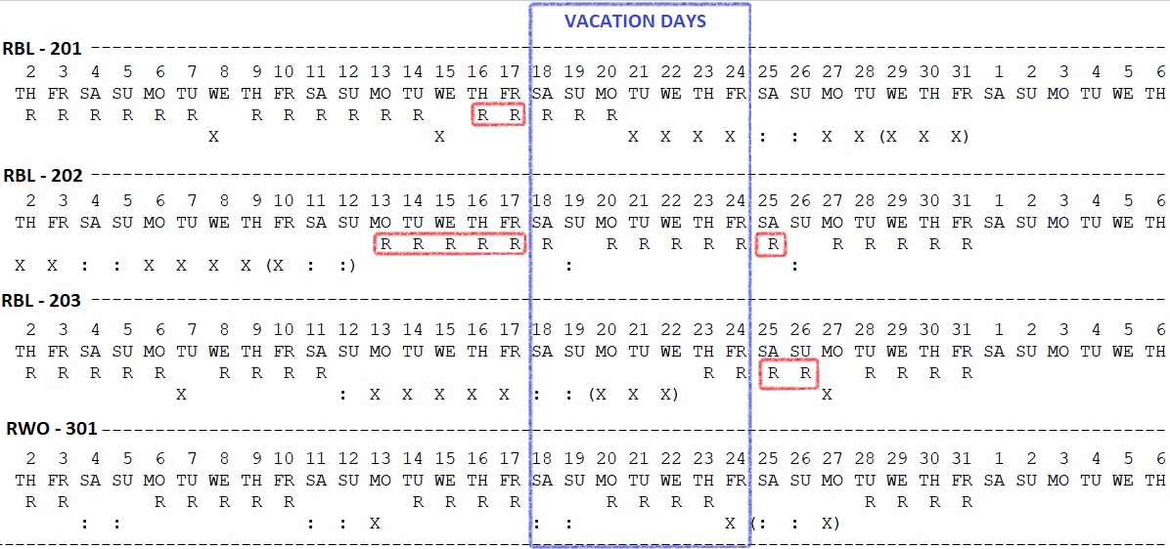
Vacation Slide Examples
Pre-bid lines contain blocks of working and off days. The RSV conflict days eligible to be covered by the slide are the RSV dates in a block not eliminated by the vacation. The dates in RED are the dates considered as RSV conflict and eligible to be eliminated by a slide request. Based on the direction you choose to slide; you must not leave any RSV day(s) uncovered.
RBL 201: You can slide VC 2 days to eliminate the 16th and 17th. VC will start 16th ends on 22nd.
RBL 202:
You can slide VC 1 day to eliminate the 25th. VC will start on 19th end 25th.
Sliding the VC 4 days to start on the 14th will not eliminate the RSV conflict since the 13th will be left as a single RSV day. The slide will be denied. However, you can slide and use a vacation extension day to eliminate the conflict on the 13th. VC will start on the 14th and end on the 20th. 1 VG to cover the 13th.
RBL 203: You can slide VC 2 days to eliminate the 25th and 26th. VC will start on 20th end on 26th.

Slide 34
Vacation Slide with Extensions for CDO, RWO, or RBL Lineholders only
If you are awarded a CDO, RWO, or RBL line and you wish to slide your vacation, you must submit an RF 200 SLID between the 15th and 20th of the month.
If you wish to extend your vacation along with your vacation slide you must submit the RF 200 SLID including both requests: slide and vacation extension. DO NOT select your vacation extension days on the “My Bidding” calendar since it will invalidate the RF request.
If you are awarded a CDO, RWO, or RBL and DO NOT wish to slide your vacation but do wish to extend, you must select your vacation extension days on the “My Bidding” calendar.

Slide 35
Vacation Extension Dos & Don’ts
DOS
DON’TS
Do select vacation extension only on days pertaining to the bid month and up to the 5th of the next bid month.
Do send a RF 200 SLID if you received a CDO, RBL, or RWO line and are going to Slide and Extend your vacation.
Do extend your vacation on the “My Bidding” page if you received a CDO, RBL, or RWO line, and will not slide your vacation.
Don’t extend your vacation if the days (Vacation and/or Extension Days) fall outside of the Bid Month and will not impact a carry-out trip.
Don’t extend Vacation into the current month.
Don’t extend Vacation on days that you are already scheduled to work.
Don’t select Vacation Extension on the “My Bidding” page if you are going to slide your vacation (use the RF).
Don’t extend your vacation more than 4 days at the end or at the beginning of a block.

Slide 36
My Bidding vs. RF 200 SLID
Who | What | How | When
I did not receive a CDO, RBL, or RWO line. | I want to EXTEND. | Select dates on “My Bidding” calendar. | 10th noon through the 20th noon central time.
I did receive a CDO, RBL, or RWO line. | I only want to EXTEND. | Select dates on “My Bidding” calendar. | 10th noon through the 20th noon central time.
I did receive a CDO, RBL, or RWO line. | I only want to SLIDE. | Use the RF 200 SLID. | 15th noon through the 20th noon central time.
I did receive a CDO, RBL, or RWO line. | I want to SLIDE and Extend. | Use the RF 200 SLID. * | 15th noon through the 20th noon central time.
I did receive a CDO, RBL, or RWO line. | I submitted the RF and want to change the dates. | Submit a new RF. | 15th noon through the 20th noon central time.
*Note: The selection of extension dates on “My Bidding” calendar will supersede any RF request submitted by the FA. Please make sure you are removing the dates if you are sliding or sliding and extending your vacation.

Slide 37
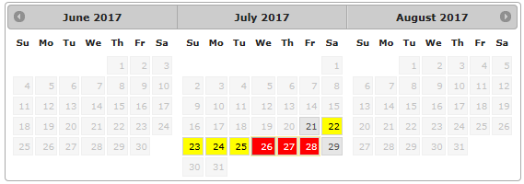

Vacation Fly-Through
Vacation Fly-Through allows the PBS Scheduler to assign flying on vacation days. You can select a portion or all of your vacation days for Fly-Through.
At the bottom of the “My Bidding” page click the blue action bar that says:
  Select the desired dates to fly through. The selected dates will appear as red.
  If you are satisfied with your selection click . Otherwise, click to go back to the calendar.
Vacation Days
Vacation Fly-Through

Slide 38
Section 3 - 1
Bid Preference System
  System Notes
  The Preferential Bidding System
  Bid Preference System Login
    Data Synchronization
    On-line Mode

Slide 39

The Preferential Bidding System

Slide 40
Important Note
The data that the NAVBLUE uses is downloaded into data storage within the computer browser called Cache.
If you are using a personal device, we suggest that every month, before making any changes to your bid, clear the Cache to ensure you are running the latest version.
Keep in mind that some systems offer the option to clear the history, if this option is available, we recommend clearing both.
For instructions on clearing or refreshing your browser’s cache visit https://www.refreshyourcache.com

Slide 41
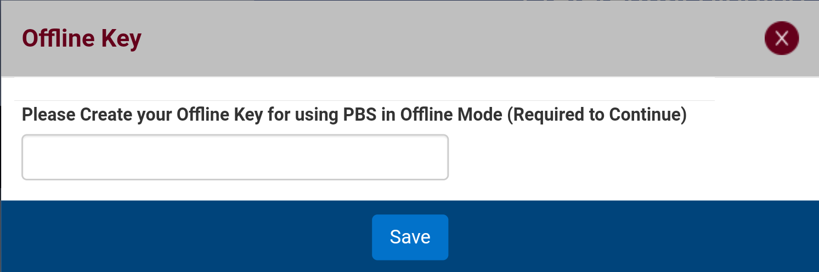
BID Preference System Login
Open My Envoy Air
Go to Departments
Click Flight Service
Click PBS, Bidding & Seniority Lists
Click Bidding System Login to open PBS
Click BID Preference System to open NAVBLUE – The system will prompt you for an Offline Key. Use 1234 as your Offline Key.

Slide 42
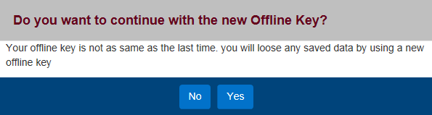
BID Preference System Login
An Offline Key warning message might pop up.
You will need to click YES to continue.

Slide 43
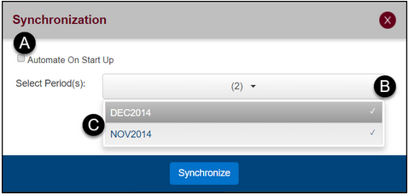
Data Synchronization
Synchronization ensures that bid period information is up-to-date while the bid period is open. After bidding is closed and awards are published, you must sync data to view your published results.
  Automate on Start Up (A) – Check this box to automatically sync the data. To save this or any setting you must click the Logout button when you exit the application.
  Select Period(s) (B) - this lets you choose how many periods of data you want to sync. The system is defaulted to sync the last two periods.
  Click on a period name (C) to select or deselect it from synchronization. The checkmark beside the name indicates that it will be synced.

Slide 44
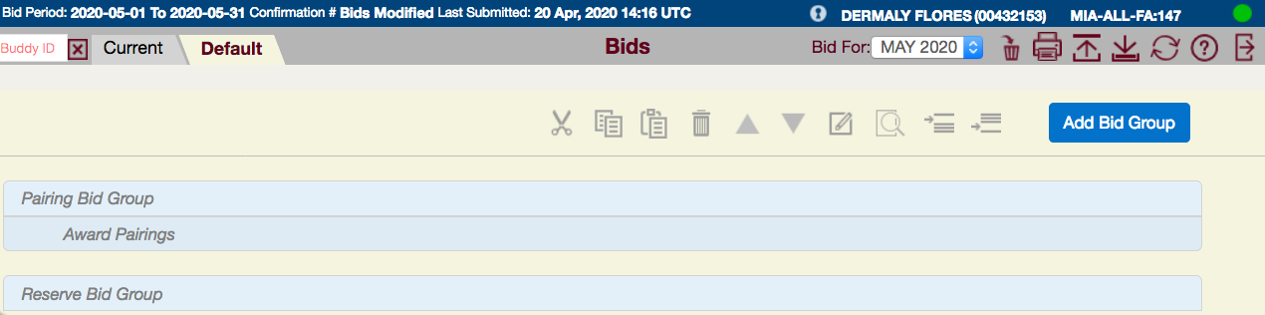
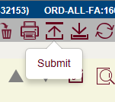

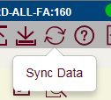
On-line Mode
You are online if the circle in the top right corner is green . Ensure you are online when working in the NAVBLUE PBS-Schedule.
When online, the Submit, Save and Sync Data buttons are available.

Slide 45
On-line Mode – Save vs Submit
Save bid does not submit your bid. This functionality will store your bid on your personal device if your browser is not set to clear the cache when logging off.
Only you can see your saved bid. Saved bids cannot be accessed between multiples browser or different devices.
If you have saved your bid, never clear your browser data before submitting your bid or you will lose all your work.
If no bid is submitted the system will use whichever bid is active (current/default). If no bid is active, the system will use the system-generated award pairing bid from the default bid.
You will automatically be logged out of the application after 30 minutes of inactivity. Any changes will not be kept unless they have been submitted.
Always submit your bid and note the confirmation number before logging out.

Slide 46
Section 3 - 2
System Basics
  Top Gray Bar
    System Version Check
  Navigation Tabs
  Info Tab
  Calendar Tab
      Lineholder Calendar Tab
      Reserve Calendar Tab
      PBS Schedule Calendar
  Pairings Tab
      Pairing Tab Notes
      Pairing Details
  Bids Tab
    Bidding Tools Available
  Bidding with Vacation

Slide 47
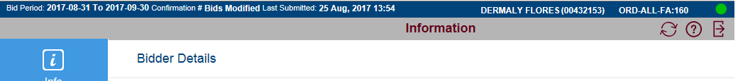

Top Gray Bar
The buttons on the top gray bar vary depending on which navigation Tab is active. The following buttons are available to you in all tabs:
Button | Function
 | Sync Data - loads the latest pairing and bid information.
 | Help - access help, release info, and version number.
 | Log out - log out of the application. Remember to log out instead of closing the browser to avoid losing changes.

Slide 48
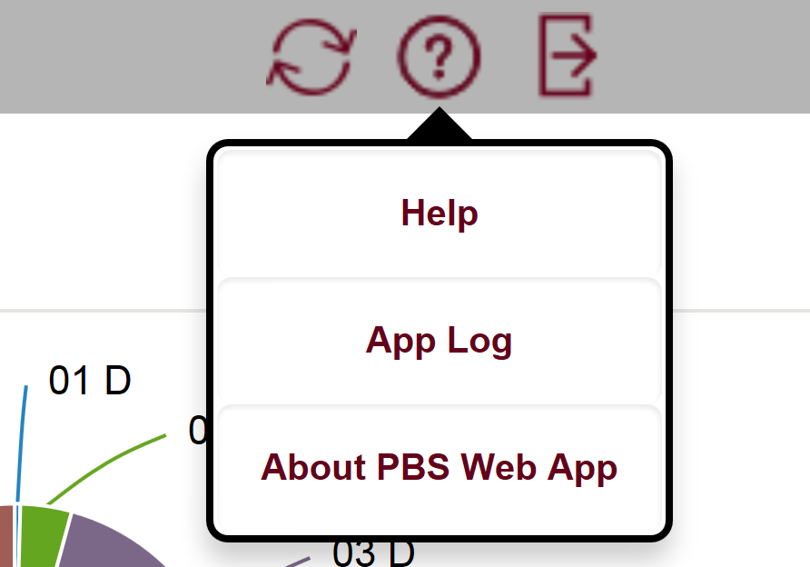
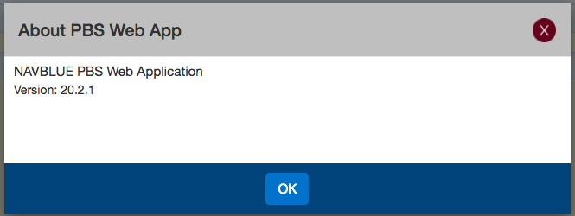
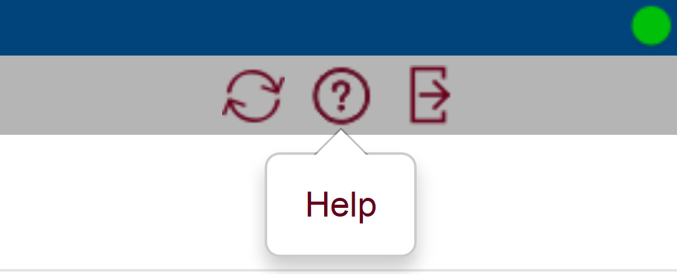
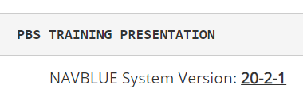
System Version Check
Click the “Help” Button located on the Top Gray Bar
Select the “About PBS Web App” option
Confirm Version
Click “OK” to close Pop-Up Message
The latest version will be published under PBS Resources Section. You are responsible for checking the version only when using a personal device.

Slide 49
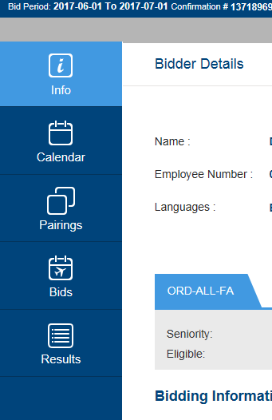
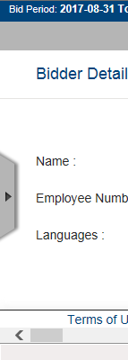





Navigation Tabs
Contains Bidder
Details
Displays Bidder
Monthly Calendar
Displays all pairings available to bid
Allows entering/changing Current or Default Bid
Displays awards and the Reasons Report
If the Navigation Tabs are not visible: Click to display it.

Slide 50
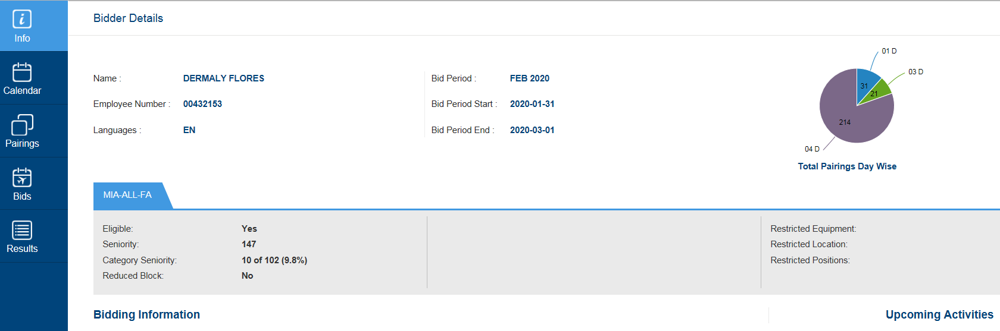
Info Tab
1
2
3
1
4
5
Bidder’s information.
Bid Period, Bid Period Start, and Bid Period End dates.
Pie Chart with Pairings distribution based on Pairing length.
Bidding information: Important notes regarding PBS changes or updates.
Upcoming Activities: Displays Carry-In Activities (transition trips/absences).
Notes:
Changed wording on #1

Slide 51
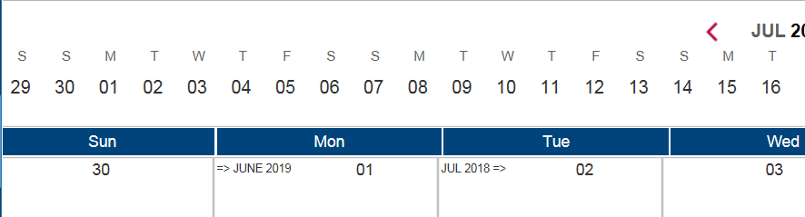
Calendar Tab
UPDATED
The Calendar displays your activities for the month (pairing, training, vacation, etc.) .
This calendar will only display activities and/or absences shown on your PBS-Awarded Schedule. Any changes (dropped trips, OT, trip trades, flight changes, absences, cancellations, reassignments, etc.) that occur after awards are posted will not be shown. Always refer to DECS, AVRS, or CCI for your most up-to-date schedule.
The Horizontal Calendar view will display the contractual month.

Slide 52
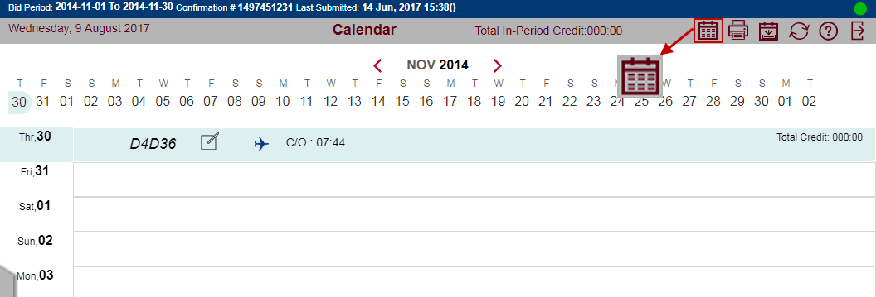
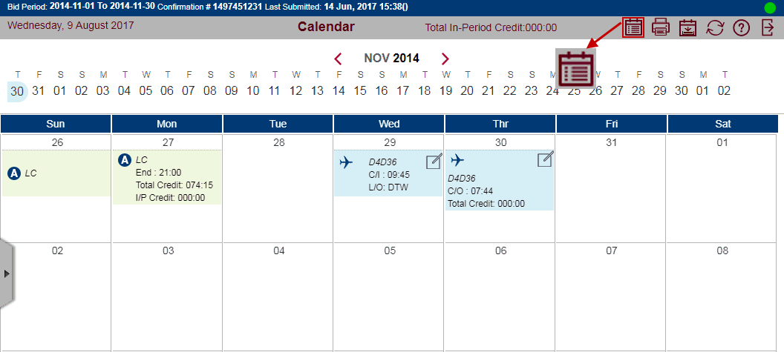
Calendar Tab
UPDATED
You can toggle between the Horizontal/Vertical Calendar or the Square calendar. To switch views, click on the calendar button at the gray bar.
Horizontal / Vertical
Square

Slide 53
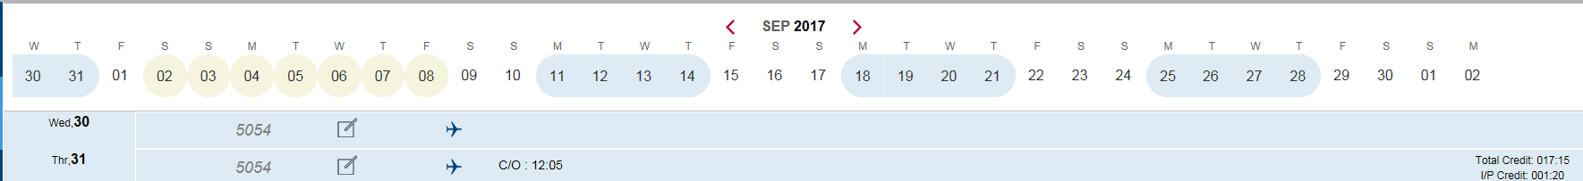


Lineholder Calendar Tab
Current Bid Period. Use the
arrows to change the month.
Click to view pairing information.
Blue Circled day = pairings
Yellow Circled day = absences

Slide 54

Reserve Calendar Tab
Current Bid Period. Use the
arrows to change the month.
Yellow Circled Days
  Previous bid month Reserve (RSV) days
  Absences
  Golden Days (RGO)
White Circled Days
  Bid Month Reserve (RES) days

Slide 55

PBS Schedule Calendar Download
Download Schedule Button – download your calendar in .ics file format for use in a number of calendar programs such as Outlook, Google Calendar, and Apple iCal.
Downloading the .ics file from the Safari browser is currently not supported.
Note: The downloaded PBS Schedule will only display activities and/or absences shown on your PBS-Awarded Schedule. Any changes (dropped trips, OT, trip trades, flight changes, absences, cancellations, reassignments, etc.) that occur after awards are posted will not be shown. Always refer to DECS, AVRS, or CCI for your most up-to-date schedule.

Slide 56


Pairings Tab
UPDATED
Show/Hide: Select which columns to show or hide; check mark indicates selected
Select/Deselect all pairings
  Sort by: drop down menu to choose how pairings are listed
  Order by: Sort pairings in ascending order
  Order by: Sort pairings in descending order
  / Enable/Disable bid mode
  Show Pairings Report: Shows all information on selected pairings
  Print the list of Pairings
  Award: Inserts the selected pairings into the bid as an Award preference
  Avoid: Inserts the selected pairings into the bid as an Avoid preference
Notes:
17.7 Version out – Show pairing dates are now at the bottom of the pairings – Updated on 1/31/18

Slide 57



Pairings Tab Notes
Pairings are listed in numerical order by pairing number, unless a different option is selected.
“Days” refers to the length of a sequence, NOT departure date.
Pairing start dates are circled green if a search is performed that includes: date range, day of the week or a specific date.
“DAYS”
Pairing Length
Notes:
17.7 Version out – Show pairing dates are now at the bottom of the pairings – Updated on 1/31/18

Slide 58

Pairing Details
Layover
Check-In / Check-Out Times
Aircraft
Pairing Length
Pairing Number
Position
Pairing Operating Date(s)
Values
Credit and TAFB
Notes:
17.7 Version out – Show pairing dates are now at the bottom of the pairings – Updated on 1/31/18

Slide 59

Bids Tab
Here you will enter, edit, analyze, and submit your Monthly Bid.
Remember:
  System must be online to submit a any type of bid.
  Current bid may only be submitted from the 15th noon CST through the 20th CST, otherwise use Default bid to submit.
  Don’t use the “SAVE” button the bid information will be lost.
  Always use the “Submit” button.
  The “Submit” button will show inactive if you haven't made any changes to your bid or you have submitted it.

Slide 60


Bidding Tools Available
The following buttons are used to create, edit, and analyze your bid preferences.

Slide 61

Bidding with Vacation
  When you have vacation in the bid month, the minimum number of days off outside of your vacation block will depend on whether you have a pairing line or a reserve line.
  Reserve lines from NAVBLUE will have 11 days off outside of your vacation. Extension (VG) days will count toward the 11 days off.
  Pairing lines from NAVBLUE will allocate days off based on your days of availability as shown in the table. Extension (VG) days will count toward days off.
  For more information about bidding with vacation, refer to Section 8 of the contract.

Slide 62
Section 3 - 3
Bidding Process
  Bid Types
  Bid Preference Editor
  Bid Preferences
  Prefer Off Bid Preferences
    Prefer Off Bid Notes
  Award Pairings Bid Preferences
      Any vs. Every Bid Preferences
      Limit Bid Preferences
    Avoid Bid Preferences
      Deadheads & Award / Avoid
  Instructions Bid Preferences
  Set Condition Bid Preferences
      ESNBG - Else Start Next Bid Group
      Credit Window Notes
  Waive Bid Preferences

Slide 63

Bid Types
DEFAULT BID | CURRENT BID
Can be modified at any time Carries over from month to month Erased if FA changes bases or has TDY Will only be used if no current bid exists Yellow background | Can be modified from the 15th noon CST through the 20th noon CST only Does not carry over Erases each bid period If created will always be read, even if a default bid exists White Background
Note: The logic does not read both bids and does not jump from one bid to the other. Default bid will be used only if no Current bid exists.

Slide 64

Bid Preference Editor
Use the Bid Preference Editor to enter your search criteria and add options to your bid.
The Home button returns you back to this list, but it leaves your last selection checked. If you were adding a Prefer Off bid, you would come back here with it selected.
The Apply button adds your bid preference. The Apply button remains gray until you have entered the proper criteria. The red text at the top of the bid explains what criteria you are missing to add a bid. On the pairing screen, the white text above the list of pairings explains what criteria you are missing to perform a search. For example, if you want to add Depart On dates and haven't entered any dates you cannot select the Apply button. When the Apply button is blue, you can click it to add your preferences to your bid.
The Close button closes the Bid Preference Editor.
The Reset All button returns you back to this list, but it removes all selections checked.

Slide 65
Bid Preferences
A single, numbered line of a bid group representing a Positive or Negative bid.
Negative Bids
Positive Bids
  Prefer Off
  Avoid Pairings
  Negative bids remove pairings from the available pairing pool. With negative bids, only one instance of the bid attribute within the pairing must match the bid preference.
  Award Pairings
  Positive bids take pairings from the available pool and add them to your block. With positive bids, the PBS Scheduler looks for pairing attributes that match the bid preference. This is an all-inclusive preference. Therefore, the pairing must meet all criteria to be awarded from the pool of available pairings.

Slide 66

Prefer Off Bid Preferences
Prefer Off bid preferences request dates or days off during the bid period. You can select days of the week, specific dates or ranges of days/dates, and times of day that you want to be free of duty.
Prefer Off bid preferences are negative bids that exclude pairings from consideration.
All Prefer Off bids can be modified with an “All or Nothing” or a “Else Start Next Bid Group” qualifier.
All or Nothing – Tells the logic that if all days requested can’t be honored then the prefer off bid should be ignored. The logic will continue to read the bid group.
  Else Start Next Bid Group – Tells the logic that if any of the days requested can’t be honored, to ignore the bid group and move to the next bid group.

Slide 67


Prefer Off Bid Notes
The PBS Scheduler takes the listing order into consideration when honoring the Prefer Off Bid Preferences.
Most Important
Least Important
Most important
Least important

Slide 68


Award Pairings Bid Preferences
  Award Pairings bid preferences identify the things that you want to do and your work preferences.
  Award Pairings bid preferences include options that identify particular characteristic of pairings that you like.
  Award Pairings bid preferences include pairings for consideration and add pairings to your block.

Slide 69

Any vs. Every Bid Preferences
Any or Every options are only available on some of the Award Pairing Bid Preferences.
  If you use Any - only one leg of the pairing has to contain the property for it to be awarded.
  If you use Every - every leg of the pairing has to contain the property for it to be awarded.
Note: Avoid is defaulted to Any. It will remove all pairings where any leg has the property that you want to avoid.

Slide 70

Limit Bid Preferences
Limit is an instruction that may be used on Award bid preferences.
Limit instructs the PBS Scheduler to award only a certain number of pairings meeting the bid preference criteria.
Limit only applies to the bid preference on which it is added and will not influence any other Award or Avoid bid preferences within your bid.
Limit is most effective when used in conjunction with a lower priority Avoid bid preference.
  Limit example bid:
  Award Pairings If Pairing Length = 4 days Limit 2
  Avoid Pairings If Pairing Length = 4 days
  Award Pairings
  With this bid, the PBS Scheduler will award you no more than two 4-day pairings, then fill the rest of your schedule with one, two, or three-day pairings.

Slide 71

Avoid Bid Preferences
Excludes pairings from consideration on any Award Pairings bid preferences that follow it in your bid.
Include most of the same options available in Award Pairings bid preferences, so you can identify types of layovers, stations, duty length, etc., that you don’t like.
It is an All Inclusive option. If you include more than one Preference on the same bid line, it will only avoid pairing(s) that meet all preferences. For example, if you want to avoid all pairings that sign in before 12:00 and you want to avoid all pairings that sign out after 17:00, your bid should include two avoid bid lines (one for each avoid).

Slide 72




Deadheads & Award/Avoid
Deadhead legs, for Award and Avoid Bid Preferences, are ignored when determining whether a pairing meets the criteria, with a few exceptions:
    “Landings In” and “Duty Legs” bid preferences will include deadheads only if you select the “Including Deadheads” checkbox. Click on “Counting Deadhead Legs” to activate the option – a green check mark will appear next to it.
    “Flight Number” bid preferences will always include deadheads.

Slide 73
Deadheads & Award/Avoid
Examples
Bid Preference | Meaning
Avoid Pairings If Any Landings In YYZ | I don’t want any pairings that have working legs into YYZ, but I don’t mind deadheading there.
Avoid Pairings If Any Landings In (Counting Deadhead Legs) YYZ | I don’t want to go to YYZ, even if it’s just a deadhead.
Award Pairings If Every Duty Legs < 4 legs | I want to be awarded pairings that work no more than 3 legs per duty.
Award Pairings If Every Duty Legs (Counting Deadhead Legs) < 4 legs | I want to be awarded pairings that have no more than 3 legs per day, even if some of them are deadheads.
Award Pairings If Any Flight Number 3300 | I want to be awarded pairings with flight number 3300. I understand this could be a working leg or a deadhead leg.
Award Pairings If Every Aircraft Type E7M | I want pairings where all the working legs are on the E7M. I understand I might get an E7M pairing that has deadheads on an EMJ or CRJ.

Slide 74
Instructions Bid Preferences
Clear Schedule and Start Next Bid Group
This bid preference will instruct the PBS Scheduler to move to your next bid group if it has not reached line completion. This bid option is only available for use in “Pairing Bid Group”.
Any bid group with this instruction must honor all your Avoid, Prefer Off, and Set Condition preferences within that bid group 100%. The bid group will not reach the generic “Award Pairings” or enter denial mode; instead, the PBS Scheduler will continue to the next bid group.
A Clear Schedule and Start Next bid is forced to the bottom of your bid group. Any bid preferences added to that bid group are forced above the Clear Schedule and Start Next bid preference.

Slide 75

Instructions Bid Preferences
Clear Schedule and Start Next Bid Group
Remember:
  Bid Groups are independent of each other.
  Bid Preferences are only relevant for the bid group they are contained in.
  Any Pairings awarded from previous bids are removed if a Clear Schedule and Start Next Bid Group is triggered.

Slide 76
updated
Instructions Bid Preferences
Clear Schedule and Start Next Bid Group
Guidelines
If you use Clear Schedule and Start Next Bid Group, keep the following points in mind:
  The PBS Scheduler only uses the specific bid preferences you provide in the bid group; optimization such as substitution and shuffling is performed to try to complete your schedule prior to executing the Clear Schedule and Start Next Bid Group command.

Slide 77

Instructions Bid Preferences
Clear Schedule and Start Next Bid Group
  This means that if the bid has this option on the last Pairings Bid Group and the Clear Schedule must be used. PBS will award a Reserve block. If there is no bid group entered, the PBS Scheduler will attempt to build you a pairings block using the Award Pairings system-generated bid groups. If a complete block still cannot be built the PBS Scheduler attempts to build you a Reserve block using the system-generated reserve bid group.
  A warning message will be displayed when a bidder submits a bid with a Clear Schedule and Start Next (CSSN) bid preference in a bid group without adding a bid group below it. The number in the square bracket indicates the bid group that has the CS or ESNBG, but no additional bid is below it.

Slide 78

Set Condition Bid Preferences
There are two ways that Set Condition bids are placed in the bid group:
  They are placed automatically at the top of the bid group, or
  They may be moved above or below Avoid and Prefer Off bid preferences.
  They are forced above Award bid preferences.
Make sure you consider the order in which bid preferences are denied, particularly if some of your Avoid Pairings and Prefer Off bid preferences are more important to you than the Set Condition bid preferences.

Slide 79
Set Condition Bid Preferences
Set Condition bid preferences tell the PBS Scheduler something about your Line by setting a global condition of some type, such as:
Pattern |  | Maximum Days On In a Row |  | Minimum Days Off In a Row
Tells the system to create a line that follows a pattern of days on and days off. You can specify a range of days on, and a minimum number of days off between duty periods. |  | Tells the system to build a block with a set number of days on in a row. |  | Tells the system to build a block with a set number of days off in a row.
Maximum Credit Window |  | Minimum Credit Window |  | Minimum Base Layover
Tells the system to award you a line as close as possible to the maximum allowed credit window. |  | Tells the system to award you a line within the minimum credit window. |  | Tells the system to create a line that provides a minimum amount of layover time at your base.

Slide 80
Set Condition Bid Preferences
Note: These two set condition bids may be partially honored in Denial Mode, unless conditioned with ESNBG.
Consecutive Days Off in A Row |  | Days Off With Employee |  | Days Off Opposite Employee
Tells the system to award a block with a number of consecutive days off in a row. You may assign a Date Range to this set condition. Remember: if you request two or more blocks of the same range in the same bid group you will be required to specify a date range on each block. |  | Tells the system to build a block with days off with a more senior crew member. A day off is defined as a day that contains no working activities. A non-working absence is considered a day off (this will apply to both FAs). |  | Tells the system to build a block with days off, within the bid period, opposite a more senior crew member. A day off is defined as a day that contains no working activities. A non-working absence is considered a day off (this will apply to both FAs).

Slide 81
ESNBG - Else Start Next Bid Group
Else Start Next Bid Group is a conditional instruction to the PBS Scheduler. When using the ESNBG option, you are telling the PBS Scheduler that if a legal schedule cannot be created using this bid preference, you want it to continue to the next bid group. The PBS Scheduler will STOP processing the current bid group, and start processing the next group.
Else Start Next Bid Group can be added to the end of all Prefer Off and Avoid bids along with certain Set Condition Bids in Pairing and Reserve bid groups.
A warning message will be displayed when a bidder submits a bid with an Else Start Next Bid Group instruction in the last bid group without adding a bid group below it.
If you use ESNBG in your last bid group, the PBS Scheduler will use the system-generated award pairings big group to complete your block. If a complete block still cannot be built, the PBS Scheduler attempts to build you a Reserve block using the system-generated Start Reserve bid group.

Slide 82
Credit Window Notes
The lowest number of minimum credit lines awarded will never be less than 5% of the domicile population.
The PBS Scheduler awards pairings normally until your total credit is above the Threshold Value for the applicable Credit Window. At this point, PBS will stop adding pairings and your block is complete.
If the Threshold Value is not achieved, but the total credit is above the Minimum Value, your block is considered complete.
If your block is not above the Minimum Value, the PBS Scheduler will utilize Shuffle, Denial Mode, and SLG to complete your block.
Minimum Credit Window
Maximum Value (91:00)
Threshold Value (65:00)
Minimum Value (65:00)
Normal Credit Window
Maximum Value (91:00)
Threshold Value (75:00)
Minimum Value (75:00)
Maximum Credit Window
Maximum Value (110:00)
Threshold Value (110:00)
Minimum Value (91:00)

Slide 83

Waive Bid Preferences
Waive bid preferences tell the PBS Scheduler that you want certain rules adjusted or disregarded to build your schedule. Some rules can be completely disregarded, while other rules can only be adjusted.
Minimum 2 Days Off In a Row
Waive the required 2 days off every time you are awarded a day off. This reduces the minimum days off from 2 to 1.
No Same Day Pairings
Allows the PBS Scheduler to award a pairing beginning the same day another pairing ends, providing you meet all legalities.
1 Day Off in 7
Allow 24 hours free from duty in lieu of a calendar day in domicile per 7-day period.

Slide 84
Bid Preferences Example
The PBS Scheduler reads the Prefer Off and Avoid Pairings preferences and immediately removes all pairings that work on Mondays and Tuesdays (Bid 2) and all pairings departing between 1:00 am and 6:00 am (Bid 3) from the pairing pool.
The Scheduler then begins to look for pairings in the available pairing pool that contain at least one layover in Miami or Boston. You will not be awarded a pairing with layovers in Miami or Boston if it works on a Monday or Tuesday or departs between 1:00 am and 6:00 am.
If the PBS Scheduler enters denial mode, Set Condition, Prefer Off, and Avoid Pairing bid preferences are all removed from your bid and your bid is reprocessed adding one by one. The Set Condition, Avoid, or Prefer off that was preventing the logic to complete the block will not be used.
Example:
Pairing Bid Group
Prefer Off Monday, Tuesday
Avoid Pairings IF Departing on Between 01:00 and 06:00
Award Pairings IF Any Layover in MIA, BOS
Award Pairings

Slide 85
Section 3 - 4
Pairing Bid Construction
  Adding a Pairing Bid Group
Import Pairings from Pairing Tab
  Import by Pairing(s) Number(s)
  Import by Pairing(s) Number(s) and Depart on Date
  Import Pairing(s) Filter/Search Information
Buddy Bidding
  Adding a Buddy
  Deleting a Buddy
Pairing Bidding Notes
Pairing Bid Logic
Coverage Award Logic
Credit Window Logic
Pairing Bid Example
Bid Analyzer
      Analyzing a Pairing Bid Group

Slide 86







Adding a Pairing Bid Group
  Click the Bids Tab
  Click Bid Type - Current or Default Tab
  Click Add Bid Group
  Click Pairing Bid Group
  Click Apply
  Select each preference using the Bid Preference Editor
  Click Apply to add each bid line
  Click Reset All to clear criteria and start over

Slide 87
Import Pairings from Pairing Tab
Notes:
You can bid for Award or Avoid from the Pairing tab.
You will be able to use up to 6 Pairing Preferences to filter your Pairing(s) search.
You will need to Start a bid group to import pairing from the pairing tab or select the group that the pairings will be imported to.
You will have 3 options when it comes to import pairing(s):
  Importing pairing(s) number(s) only,
  Importing pairing(s) number(s) and departing on date(s), and
  Importing filter/search information only.
You can’t import using multiple options at once.

Slide 88


Import by Pairing(s) Number(s)
  Go to the Bid Tab and select a bid line. PBS will import the Pairing Information below the selected bid line.
  Click Pairings Tab.
  Click “Enable add bids mode”.
  Search for Pairings using Pairing Preferences.
    And/or use “Sort by” button
  Click Apply.

Slide 89





Import by Pairing(s) Number(s)
  Click the checkmark to select desired pairing(s).
  Click Award or Avoid to import pairing(s) number(s) to your bid.
  Go to your Bid tab and review import.
    *You will need to manually edit the imported pairing(s) to reflect the position.
  Click “Reset” on Pairing Preferences in order to start a new search on the pairing tab.

Slide 90

Import by Pairing(s) Number(s)
and Departing on Date(s)
  Go to the Bid Tab and select a bid line. PBS will import the Pairing Information below the selected bid line.
  Click Pairings Tab.
  Click “Enable add bids mode”.
  Search for Pairings using Pairing Preferences.
    And/or use “Sort by” button .
  Click Apply.
  Click the checkmark to select desired pairing(s).

Slide 91
Import by Pairing(s) Number(s)
and Departing on Date(s)
  If a pairing is scheduled to depart in more than one date, select the desired date. It should highlight dark blue.
  Click Award or Avoid to import pairing(s) number(s) to your bid.
  Go to your Bid tab and review import.
    You will need to manually edit the imported pairing(s) to reflect the position.
  Click “Reset” on Pairing Preferences in order to start a new search on the pairing tab.

Slide 92
Import Pairing(s) Filter/Search Information
  Go to the Bid Tab and select a bid line. PBS will import the Pairing Information below the selected bid line.
  Click Pairings Tab.
  Click “Enable add bids mode”.
  Search for Pairings using Pairing Preferences.
    And/or use “Sort by” button .
  Click Apply.

Slide 93

Import Pairing(s) Filter/Search Information
  Click the checkmark to Enable “Pairing Filtered Award” box.
  Click Award or Avoid to import pairing(s) number(s) to your bid.
  Go to your Bid tab and review import.
  To start a new import from the pairing tab, go to the Pairing Preferences and Click “Reset” .

Slide 94
Buddy Bidding
A buddy bid lets you identify another crew member to bid with, and tries to create blocks for each buddy that have the same pairings on the same dates.
Each crew member must enter the other crew member as a buddy for buddy bidding to occur. The senior crew member is processed at the same seniority as the junior crew member.
Crew members who are buddy bidding with a more junior crew member should also submit a non-buddied bid group, even though it won’t be used for buddy bidding. If something happens, such as the other buddy forgetting to enter your employee number or entering the wrong employee number, the PBS Scheduler will process their bid at their regular seniority to create their block.
Note: The Buddy bid box is showing all times. However, you must ensure to enter the buddy bid number within the correct bid type (Current or Default).

Slide 95





Adding a Buddy
Go to the Bids screen and choose the Bid Type: Current or Default.
Click on the red X right to the Buddy ID. It will turn into a red checkmark.
Enter your Buddy’s employee number. You must to enter 00 + employee number. The number you enter is red until you have entered a valid employee number. A valid employee number will turn green.
Click on the check mark again to lock the employee number. The ☑ check mark turns into an X.
Notes:
Adding information on how to remove buddy per Wendy Roche request

Slide 96

Deleting a Buddy
To delete a Buddy:
Repeat steps 1 and 2.
Delete the employee number.
Click on the red check mark again to lock empty box.
Note:
If you do not click on the check mark to lock the box when adding, changing, or deleting a buddy, the following message will be displayed:
Click on the check mark to lock or OK if you want to continue without locking.
Notes:
Adding information on how to remove buddy per Wendy Roche request

Slide 97


Pairing Bidding Notes
Unless the ORDER feature is selected, the PBS Scheduler considers items (departure dates, pairings, position, etc.) within a comma-separated list on the same Award/Avoid bid line to have equal preference.
If something is more important to you than another, it should be on a separate bid line entered in priority order.
Information separated by a comma is equally important
More important
Less important

Slide 98


Pairing Bidding Notes
          The ORDER feature is available when selecting pairing number departing under the award bid preference.
          Selecting NO tells the system that all pairings in the same bid line are equally important.
Selecting YES tells the system that the order of pairings matters:
You can use the arrows to select the order of the pairings before applying your selection to an award bid line.
Most important to Least important

Slide 99
Pairing Bid Logic
Starting at the top of your Pairings bid group, the PBS Scheduler reads each of your bid preferences and remembers all restrictions you specify. The PBS Scheduler must honor all Set Condition, Prefer Off, and Avoid Pairings bid preferences.
When the PBS Scheduler reaches your first Award Pairings bid preference, it searches the pool of available pairings (now restricted by any prior Prefer Off and Avoid Pairings bid preferences) and begins awarding pairings that match this preference.
Each attempt to place a pairing in your block undergoes a rule check to ensure that the resulting block is legal. If the PBS Scheduler has awarded as many pairings that match this Award preference as possible and your block is not complete, it moves on to the next bid line. The PBS Scheduler continues to read your bid until it completes your block or reaches the last bid line.

Slide 100
Pairing Bid Logic
Once your block is complete, the PBS Scheduler stops processing your bid, even if it has not read all the bid lines.
If your block is still not complete when the PBS Scheduler reaches your last bid line, it reads the system-generated bid preference, Award Pairings, and begins to fill your block by awarding any available pairings that respect your Prefer Off, Avoid Pairings, and Set Condition bid preferences.
If the block is still not complete, the PBS Scheduler tries to replace pairings with alternatives that match the same or lower bid preferences and still honor your Set Condition, Prefer Off, and Avoid Pairings bid preferences. For example, the PBS Scheduler may remove one pairing that matches bid preference 6 and replace it with two pairings that match bid preference 7 to complete the block. This action is called Shuffling.

Slide 101
Pairing Bid Logic
Shuffling only considers pairings that have been awarded by Award bid preferences that appear after the last negative bid preference in the bid.
Note that shuffling tries to create a complete block by replacing pairings that match a higher bid with pairings that have more credit value.
Shuffling is the only time when pairings that match a lower bid may be awarded instead of pairings that match a higher bid.
If shuffling does not produce a complete block, the PBS Scheduler enters Denial Mode.

Slide 102
Pairing Bid Logic
In Denial Mode, the PBS Scheduler deletes your Set Condition, Prefer Off, and Avoid Pairings bid preferences.
The PBS Scheduler clears your block and goes back to the top of your bid, and starts processing each bid preference again. The PBS Scheduler continues to re-add deniable bid preferences, reprocessing your bid until it reaches the credit window.

Slide 103
Pairing Bid Logic
Denial Mode handles certain deniable bid preferences differently than others.
Set Condition and Avoid Pairings bid preferences are removed completely, even if you have more than one option on the bid preference, such as Landings In AGU, or YYZ.
Prefer Off bid preference options are removed one at a time if you have more than one option on the bid preference, such as a list of preferred days off. In this case, Denial Mode removes the date at the end of the list first and works towards the left if it needs to remove additional days or dates.
The PBS Scheduler tries to get every block above the threshold credit value. However, if your block is above the minimum credit value, the PBS Scheduler will not go into Denial Mode forcing your block above the threshold credit value.

Slide 104
Pairing Bid Logic
If Denial Mode has removed all deniable bid preferences without producing a complete block, the PBS Scheduler tries to create a block using only the Award bid preferences.
If the PBS Scheduler still can’t create a block, it makes a final attempt using only the system-generated Award Pairings bid preference. This final attempt, called secondary line generation (SLG), ignores all preferences and performs an exhaustive search to find you a complete block.
If you don’t have any deniable bid preferences, Denial Mode goes directly to the final completion attempt and attempts to find you a complete block using SLG.

Slide 105
Coverage Award Logic
Coverage Awards will occur when there is an excessive number of pairings remaining in open time on a certain date(s). Some of these pairings must be assigned to ensure adequate operational coverage.
Stacks are groups of pairings operating within a critical period that remain unassigned. Stacks may result from spikes in the flight schedule or an abnormally high number of requests for the same day off, such as Thanksgiving or Christmas Day.
The PBS Scheduler begins awarding pairings from the stack(s) in inverse seniority order, subject to legalities and pre-awards.
After awards are published, coverage award pairings can be treated as any other awarded pairing for swapping, dropping, and trading purposes.

Slide 106

Coverage Award Logic
Coverage Awards are assigned before any bid preferences. The PBS Scheduler attempts to match your coverage award(s) with your award/avoid bid preferences.
Once a pairing from a stack has been forced onto a block, the pairing is marked as unmovable and can’t be swapped or substituted from the block. The rest of the block must be built around the pairing or pairings awarded for coverage, using the Crew member’s bid.
Coverage awards are colored purple on the bid result.
Coverage awards are listed in the order in which they were awarded by the PBS Scheduler on the Reasons Report.

Slide 107
Credit Window Logic
The PBS Scheduler utilizes three separate, biddable Credit Windows for awarding full-time blocks. The bid preferences determine which Credit Window is used for bid processing.
Each Credit Window (Maximum, Normal, and Minimum Credit) is comprised of three Credit Values (Maximum, Threshold, and Minimum Value) which are utilized by the PBS scheduler in processing the bids.
  If a Crewmember bids Set Condition Maximum Credit, the global parameters for the bid are set to the Maximum Credit Window.
  If a Crewmember does not have a preference for credit, the global parameters for the bid default to the Normal Credit Window.
  If a Crewmember bids Set Condition Minimum Credit, the global parameters for the bid are set to the Minimum Credit Window.

Slide 108
Credit Window Logic
For any given completion attempt, the PBS Scheduler awards pairings normally until your total credit is above the Threshold Value for the applicable Credit Window. At this point, the PBS Scheduler stops adding pairings and your block is complete.
If Threshold Value is not achieved, but the total credit is above the Minimum Value, your block is considered complete—the PBS Scheduler will not utilize Shuffling or Denial Mode to force your block above the Threshold Value.
However, if your block is not above the Minimum Value, the PBS Scheduler will utilize Shuffling and, if necessary, Denial Mode to complete your block.

Slide 109
Credit Window Logic
Maximum Credit Window (Set Condition)
Maximum Value (110:00)
Threshold Value (110:00)
Minimum Value (91:00)
Denial Mode
Normal Credit Window
Maximum Value (91:00)
Threshold Value (75:00)
Minimum Value (75:00)
Minimum Credit Window (Set Condition)
Maximum Value (91:00)
Threshold Value (65:00)
Minimum Value (65:00)
Denial Mode

Slide 110
Pairing Bid Example
Jack is a commuter from STL based in Chicago. Jack can't typically get to ORD when he commutes until 10 am and must leave by the 6 pm flight out to avoid another night in a commuter hotel. Jack really doesn't care when he works or where he goes although he typically likes one pairing to BWI per month. His anniversary is this month, and he would like to be off from the 14th to the 17th, in that order of priority. One thing that Jack likes to do is sleep at home whenever he can!
Pairing Bid Group
Prefer Off Dec 14, 2017 - Dec 17, 2017
Award Pairings If Layover In BWI If Pairing Check-In Time > 09:59 If Pairing Check-Out Time < 18:01 Limit 1
Avoid Pairings If Pairing Check-In Time < 10:00
Avoid Pairings If Pairing Check-Out Time > 18:00
Award Pairings If Layover In STL
  Start Pairings
  Award Pairings
  Start Reserve

Slide 111
Pairing Bid Example
Jen likes to have the PBS system work for her. She lives in base and doesn't really care when she shows up and checks out. Jen likes layovers in Mexico, preferably ones with at least 18 hours of layover time. She would rather do MZT but doesn’t mind AGU or SLP if she can’t get MZT. She can always hold the Mexico pairings that depart on Mondays, her preference. There was, however, one pairing that caught her eye. Pairing 13059 really looked appealing and she wants to get this before anything else, but only one since it looks like a tough one. If she must fill her block up to complete it, she would prefer one or two-day pairings.
Pairing Bid Group
Award Pairings If Pairing 13059 Limit 1
Award Pairings If Departing on Monday If Layover In MZT If Layover Duration > 018:00
Award Pairings If Departing on Monday If Layover In AGU, SLP If Layover Duration > 018:00
Award Pairings If Pairing Length Between 1 days And 2 days
Start Pairings
Award Pairings
Start Reserve

Slide 112
Bid Analyzer
The Bid Analyzer is a tool that shows you how many pairings match a negative or positive bid preference.
It shows you how your bid affects the available pairing pool. You can use this information to determine how effective a bid preference or your entire bid group is.
For example, if a bid preference doesn't match any pairings in the available pool, it won't have any effect on your award. If your negative bids remove a large number of pairings or all pairings from your pairing pool, some of your bids will be denied.
Note: The Analyzer only determines the effectiveness of your Pairing Bid. Just because a pairing is within the pairing pool does not necessarily mean it will be awarded. The Analyzer does NOT consider seniority.

Slide 113
Bid Analyzer
Pairing Bid Group
Analyzes a Pairing Bid Group.
Does not consider Set Condition or Waive Bid Preferences.
On a negative bid, the analyzer shows you how many pairings are removed from the available pairing pool.
On a positive bid, the analyzer shows you how many potential pairings are in the pairing pool.
You can use the bid analyzer to evaluate a single bid line or your entire bid group.
Prefer Off
Award
Avoid
Available pairing pool
Potential Pairings that match your Bid

Slide 114



Analyzing a Pairing Bid Group
To use the Bid Analyzer on a Pairing Bid Group:
  Add an Award/Avoid Pairing or Prefer Off Bid line.
  Click the Pairing Bid Group line to highlight the entire bid group.
  Click the analyzer button. The Bid Analyzer opens at the bottom of the screen.
  Click on a bid line to view the pairings that match the criteria on that specific line.
Filtering a Prefer Off bid line will tell you how many pairings conflict with the preferred day off

Slide 115



Analyzing a Pairing Bid Group
Click the expand button to view the results in full screen. The results are a list of pairings that match the bid group.
Click to close the Analyzer.
Filtering an Award Pairings bid line will tell you how many pairings match the selected criteria.

Slide 116
Analyzing a Pairing Bid Group
  There are 3 sets of numbers below each heading (137:284:284). These numbers indicate the number of pairings, pairings on dates and pairing instances.
  Pairings – how many pairings match the bid preference (137).
  Pairings on dates – how many times the pairings operate in the bid period (284).
  Pairing Instances – how many positions are available on the pairings in the bid period (284).

Slide 117
Analyzing a Pairing Bid Group
  Understanding the Results:
  Matching →how many pairings match the bid group.
  (-) Filtered →how many pairings have been removed by a negative bid preference. These pairings won’t be awarded unless denial mode is used.
  Filtered → how many pairings are in the available pairing pool. This is the number of pairings that PBS Scheduler will consider when awarding your block unless denial mode is used.
  (+) Preferred → how many pairings have been added to the Preferred Pairing pool.
  Preferred → how many pairings are in the preferred available pairing pool. These are the number of pairings that match your bid preferences (what you have requested in your bid group).

Slide 118
Section 3 - 5
Reserve Bid Construction
  Reserve Bidding
  Adding a Reserve Bid Group
  Reserve Bidding Options
  Reserve Bidding Set Conditions
  Reserve bidding Waive Notes
  GDO - Reserve Golden Day Processing
  Reserve Bid Logic

Slide 119
Reserve Bidding
The contract provides that reserve FAs will have:
11 days off in the bid month. The default distribution of these days are: one block of 4 days off, one block of 3 days off, and two blocks of 2 days off (4-3-2-2).
No single day off between reserve blocks.
No single reserve day. However, you can request a single RSV day if the single day is adjacent to a working day (s). For example, a working day from the previous bid month, training, etc.
Day off periods may not be separated by less than two (2) days of availability or by more than six (6) days of availability.

Slide 120
Reserve Bidding
Remember: RBL and RWO lines can only be bid on during the Pre-Bid process. This section only refers to creating a Reserve Bid Group within your bid in the PBS Scheduler (NAVBLUE).
The Reserve Bid Group instructs the PBS Scheduler to build you a reserve schedule.
The PBS Scheduler does not move back to your previous bid groups. All preferences must be restated in each bidding group.

Slide 121



Adding a Reserve Bid Group
  Click Add Bid Group
  Click Reserve Bid Group
  Select Apply
  Add or edit your Bid Preferences using the Bid Preferences Editor

Slide 122




Reserve Bidding Options
Note: For all Prefer Off options, please refer to the Prefer Off in the Bid Preferences Section.

Slide 123
Reserve Bidding Set Condition
Pattern tells the PBS Scheduler to create a Reserve block that follows a pattern of days on and days off. For a reserve line Pattern Bid, an in-period working pre-award that is too short does not violate the pattern.
You can specify a maximum range of days on duty.
You can specify a minimum number of days off between duty periods.
You can request one or multiple groups of a certain amount of consecutive days off in a row.
You can request specific days off with or opposite to a specific employee senior to you.
Remember: A working pre-award, such as training or a carry-in pairing, is considered to be a day on, and a non-working pre-award such as vacation is considered to be a day off (for purposes of Set Condition).

Slide 124
Reserve Bidding Set Condition
Maximum Days On in A Row
Tells the PBS Scheduler to build your block with a set number of days on in a row—the number of days off is set by you when you enter the bid.
The PBS Scheduler will attempt to create all sets of days on to the number entered—if it cannot build all sets to the number requested the bid preference will not be honored.
Minimum Days Off in A Row
Tells the PBS Scheduler to build your block with a set number of days off in a row—the number of days off is set by you when you enter the bid.
The PBS Scheduler will attempt to create all sets of days off to the number entered—if it cannot build all sets to the number requested the bid preference will not be honored. *There are some exceptions.
We recommend not setting Minimum Days Off between reserve blocks to higher than 3 and Maximum days on to lower than 3. They can have a detrimental effect on getting the days off you request.

Slide 125



Reserve Bidding Set Condition
Consecutive Days Off in A Row
Tells the PBS Scheduler to build a block with a set number of consecutive days off in a row.
You can request one or multiple blocks with this set condition.
If more than one block of the same amount of consecutive days off is requested, a date range has to be assigned to each block. Otherwise, just one block with the specified amount will be honored.

Slide 126
Reserve Bidding Waive Options
Minimum 2 Days Off In a Row: Allows your schedule to be completed with instances of single days off.
Block of 4 Days Off: Allows your schedule to be completed without a block of 4 days off.
Block of 3 Days Off: Allows your schedule to be completed without a block of 3 days off.

Slide 127
Reserve Bidding Waive Notes
There is no waiver for two blocks of 2 days off. However, the two blocks of 2 days off must exist by themselves or within a larger group of days off.
Examples:
  A block of 5 days off in a row contains the 2 blocks of two days off together
  Two separate blocks of 3 days off in a row contain one block of 2 days off each.
When requesting specific days off on a reserve bid, plot out those days on a contractual calendar to determine if waivers are needed. Keep in mind that FARs require no more than 6 reserve days in a row, and your previous month’s schedule will be considered to meet this legality.

Slide 128
GDO - Reserve Golden Day Processing
Golden Days are identified as RGO on the Reasons Report and are awarded to Reserves who have a full 11 days off in the bid month. They are awarded after your schedule has been completed, according to the CBA section 7.D.2 and to the following constraints:
  GDOs must be three consecutive days off.
  GDOs must begin on the first day of a block of days off.
  GDOs will be placed according to the flight attendant’s bid, if possible.
  If none of the preferred off bids can be contained within GDOs, GDOs will be placed according to coverage needs.
  If there are no preferred off bids, GDOs will be placed according to coverage needs.
  If there are no blocks of three or more days off, no GDOs will be awarded.

Slide 129
Reserve Bid Logic
Unlike in a pairing bid group, when awarding a reserve block, the PBS Scheduler does not perform any optimization, such as substitution, swapping, or shuffling, nor does the PBS Scheduler enter denial mode.
Coverage Awards may occur to ensure adequate reserve staffing. The PBS Scheduler tries to award each FA a reserve block that honors as many reserve bid preferences as possible.
When the PBS Scheduler starts processing a Reserve bid group, it reads the first line Start Reserve and checks to see if a legal reserve line can be built, and then, if possible, a legal reserve block is built.

Slide 130
Reserve Bid Logic
The PBS Scheduler reads the first bid preference and then attempts to build a reserve schedule honoring this bid preference.
The PBS Scheduler then reads all subsequent bid preferences, in order from top to bottom, and attempts to build a reserve block honoring as many of these preferences as possible while keeping any preferences already honored.
  For example, if the first bid preference is honored but the first and second together cannot be honored, the second preference is denied, and the PBS Scheduler will read the third preference and attempts to honor preferences 1 and 3. This process is continued until all bid preferences have been attempted.

Slide 131
Section 3 - 6
Bid Results
  Results Tab
  Reasons Report
  Bid Protest

Slide 132

Results Tab
Displays the pairings you have been awarded for the current bid period, as well as the Reasons Report explaining how the PBS Scheduler handled each of your bid preferences.
The gray bar at the top of the screen displays the credit for the period. Here you can view results from previous months, sort your awards with the available criteria, and view multiple pairing reports. You can click on a pairing number to view a single pairing report.
The Results Tab has two sections, Awards and Reasons.

Slide 133

Results Tab
The Awards pane displays the pairings that you have been awarded for the current bid period. By default, each pairing is displayed on a separate line, arranged chronologically by date and time. You can sort activities and change the display order. The Awards section also displays training, vacation, and/or other activities that were considered when awarding your schedule.

Slide 134

Reasons Report
The Reasons report shows the results of each bid preference in your bid. This information can prove useful when bidding in the next period.
Each bid preference is numbered, followed by any pairings that were awarded as a result of the bid preference, and an explanation of how the bid preference affected your block.
Carry-out pairings are marked with an asterisk (*).

Slide 135
Bid Protest
Click the Bid Protest tab.
Enter your email address*.
Type your message.
Click “Send Mail.”
          * Bid Protest responses will be sent to the email address you provide.

Slide 136
Section 3 - 7
Reasons Report
  Reasons Report Definitions
  Reasons Report FAQ

Slide 137
Reasons Report Definitions
Awarded by previous bids: X – X number of pairings matched this bid preference and were already awarded by a previous bid.
Awarded for coverage under a different bid pairings matching this bid preference were already awarded and are listed under a different bid preference.
Awarded to senior bidder pairings matching this bid preference were already awarded to a bidder with higher seniority than you.
Awarded to senior shadow bidder pairings matching this bid preference were already awarded to a shadow bidder with higher seniority than you.
Best Line Before the PBS Scheduler attempted to build a pairing block, but it could not be built using your bid preferences, so the PBS Scheduler moved to your next bid group, the results of this attempt are listed in your Reasons report.
Best Line Before Empty: No Pairing Awards Possible the best line before is empty, the PBS Scheduler could not build a block with the pairings left in the available pairing pool.

Slide 138
Reasons Report Definitions
Best Line Before Empty: Available Pairing Credit Insufficient (Line Not Attempted) the previous pairing completion attempt produced an empty best line before because there was insufficient available pairing credit to build a line so it was not attempted
Best Line Before Empty: Block Time Limit Insufficient (Line Not Attempted) the previous pairing completion attempt produced an empty best line before because the N-PBS Scheduler calculated that a crewmember’s Block Time Limit makes it unrealistic to complete a block
Best Line Before Empty: SLG Could Not Find Line Including Priority Stack Date an SLG completion attempt produced an empty best line before because SLG quit early as it was required to include the priority stack date and could not.
Beyond bid limit: X X number of additional pairings matched this bid preference, but none were awarded because you placed a limit on the bid preference.
Bid denied this bid preference was denied, and there are pairings on your block that contradict this preference.

Slide 139
Reasons Report Definitions
Block is complete this bid preference was not used to build your pairings because your pairings block was already complete before reaching this point.
  If a number appears after the ”Block is complete” reason, it indicates the number of pairings that matched the bid but were not awarded because your block was already complete. That is, it reached the credit value.
Buddy cannot take pairing your buddy could not be awarded this pairing, so it can’t be awarded to you either.
Could Not Build Complete Line with Pairing the pairing is available legally but cannot be used because it could not fit into your block and still build a complete block.
Filtered by higher bid: X X number of pairings matched this bid preference but were filtered out of the available pairings pool by Avoid Pairings or Prefer Off bid preferences that were higher in your bid.
Honored this bid preference was used, and there are no pairings on your block that contradict this preference.

Slide 140
Reasons Report Definitions
Item overlaps with another: X X number of pairings matched this bid preference but overlapped with something already awarded.
Matching: X the total number of pairings that match this bid preference.
Maximum Max-Credit bidders Reached - the maximum number of Maximum Credit blocks have already been awarded.
Maximum Min-Credit bidders Reached - the maximum number of Minimum Credit blocks have already been awarded.
Max Pairing Lines Reached - the maximum number of Pairing lines has already been awarded. This amount does not include shadow bidders.
Minimum Base Layover line condition violated the minimum base layover line condition could not be met with this bid preference, and some layovers are shorter than the minimum time requested.

Slide 141
Reasons Report Definitions
Minimum days off not met this bid preference was denied due to not meeting the required 2 days off in a row between assignments.
Needed for Legality this pairing was awarded from a lower bid preference to honor either a Min Days Off, Min Days On, or Pattern Set Condition bid preference.
Not considered this bid preference was denied, but there are no pairings on your block that contradict this preference.
Not enough days off in range this bid preference was denied due to reducing the guarantee of 11 days off, or prorated amount due to vacation or LOA.
Not honored this bid preference was denied, and there are pairings on your block that contradict this preference.
Not used this bid preference was not used to build your block; either because your block was already complete or because you used a Clear Schedule and Restart bid preference.

Slide 142
Reasons Report Definitions
No pairings available no pairings that met your Avoid Pairings and Time Prefer Off bid preferences were available to be awarded, usually, because too many pairings were eliminated from the pairings pool by your Avoid Pairings and Time Prefer Off bid preferences.
Partially honored this Time Prefer Off bid preference was used, but there are also pairings on your block that contradict a portion of this preference. If you submit a range of dates that you want to be free of duty, the PBS Scheduler may be able to honor part of the range but not all of it, resulting in a partially honored bid preference.
[Rule violation] a FAR rule, or other legal consideration, prevented this bid preference from being honored The rule is identified in the reason included in your report.
Over maximum credits for period the pairing would have caused your block to exceed the maximum credit value for the bid period.
Violates bid # X - the pairing is legal and available, but if awarded will violate a Prefer off bid line (i.e. Prefer Weekends Off / Prefer Off Sundays).

Slide 143
Reasons Report Definitions
Additional Messages
You may see the following messages at the top of your Reasons report. These messages indicate that the PBS Scheduler had to ignore some of your preferences in order to give you a complete block or meet legal requirements or airline targets.
Affected By Denial Mode the PBS Scheduler had to deny some or all your bids in order to build you a complete block.
Affected by SLG the PBS Scheduler could not build you a block using any of your preferences and reached the end of Denial mode, so your block was built using secondary line generation (SLG).
Affected By Coverage a pairing or pairings were forced onto your block in order to meet airline targets for the total number of pairings remaining in open time. In the case of a Reserve, a reserve day was forced onto the block.

Slide 144
Reasons Report FAQ
Minimum Credit
I bid for Minimum Credit Window and my Reasons Report says it was honored. Why do I have an 80 hour line?
Answer:
“Set Condition Minimum Credit Window” is simply an instruction to stop adding pairings to a block once the minimum window threshold is achieved. In this bid, the PBS Scheduler did not reach 65:00 hours with the first 3 pairings it awarded. Another pairing was required, and it selected a fourth pairing meeting the preference on bid line 4, even though there may be another pairing with a lower credit value that would have allowed line completion.

Slide 145
Reasons Report FAQ
Buddy Bid
I buddy bid. My buddy is junior to me and we both end up on reserve. What is going on?
Answer:
When two bidders designate each other as buddies (by entering the other’s employee number on their bid), the PBS Scheduler honors the buddy bid. The senior buddy forfeits their position, is processed at the level of the junior, and adopts the junior buddy’s bid. This is true even if there are no “buddiable pairings,” and even if the junior can only hold reserve.

Slide 146

Reasons Report FAQ
Could Not Build Complete Line with Pairing
Results with Shuffling
I bid for specific pairing. Why was my first preference “Could Not Build Complete Line with Pairing?”

Slide 147

Reasons Report FAQ
Could Not Build Complete Line with Pairing
Results without Shuffling:
Answer:
Using Shuffling, the PBS Scheduler was able to complete your line using pairings from your “award” bids. If your first preference was not pulled during shuffle, the PBS Scheduler could not reach line completion (triggering denial mode or SLG).

Slide 148

Reasons Report FAQ
In-Period Credit
I waived everything to get a line and I ended up on reserve, but people junior to me got lines. How come?
Answer: If you are placed on reserve, and someone junior to you has a line, the junior FA likely has a carry-in trip or a pre-planned credit absence that allowed the Scheduler to meet the credit requirement.
Even if the junior FA does not have either of those, you may not be legal for a trip at the beginning of the bid-month if results in 7 straight days of duty.
Above, Envoy FA1 has reserve days from June 29th through July 1st. FA1 is not legal for the 4-day sequence 29271 on July 2nd, because that would be 7 days without a 24-hour break. Envoy FA3 had a carry-in trip with 16:04 in-period credit that allowed the Scheduler to reach the credit window. Envoy FA4 has an in-period credited absence worth 7:30 which allowed line completion.

Slide 149

Reasons Report FAQ
Bid Order
I requested July 4th off and no position 2. Why am I working the 4th, and how come all my trips are positon 2?
Answer:
The Scheduler reads your bid one line at a time. Any “prefer off” or “avoid” within a bid group will only apply to the “award” preferences that fall below it. In this bid, the schedule was completed at line 5. The flight attendant should have placed lines 6 and 7 above line 5 if they want off July 4th and no positon 2 trips.

Slide 150

Reasons Report FAQ
Bid Groups
I wanted July 23rd off and no E7M trips. Why am I working on the 23rd on the E7M?
Group 1
Answer:
The Scheduler organizes your bid in groups. Each group is read independently.
In this bid, the flight attendant listed the “prefer off” and “avoid” only in the first bid group. Once the first bid group couldn’t build a line, it was ignored, and the Scheduler awarded pairings using the preferences in the second bid group.
Group 2

Slide 151

Reasons Report FAQ
Coverage Awards
My Reasons Report has a “Coverage Awards” section. What’s that about?
Answer:
When your result is affected by coverage, a pairing or pairings were forced onto your block to meet airline targets for the total number of pairings remaining in open time. This usually occurs when an abnormally high number of FAs request a specific day off, like Thanksgiving or Christmas.
The coverage award is locked into your schedule prior to the system reading your Preferences.

Slide 152
Reasons Report FAQ
Reserve Bid
Why did someone junior to me receive some of the days that I requested off when I didn’t?
Answer:
The PBS Scheduler can only create a Reserve Schedule that both complies with FARs and the FA Agreement.
This bid is missing waivers (“Block of 4 Days Off” and “Minimum 2 Days Off in a Row”), making it impossible for the Scheduler to honor all days off without violating reserve defaults.
The PBS Scheduler had to “partially honor” days off, by following the order of importance in the Prefer Off bid:
Most
important
Prefer Off Days Line
Least important

Slide 153

Reasons Report FAQ
Reserve bid, continued
This number represents order of importance for each day, based on the Prefer Off bid line .
Logic Explanation:
There is no block of 4 days off and the FA did not waive the Block of 4 days off.
There is a single day off (July 7th) and the FA did not waive the Minimum 2 Days Off in a Row.
There is room to build a block of 4 days off at the end of the month by adding a day off on July 28th.
The Scheduler will try to build a line by denying the least important Prefer Days Off in this bid.
July 7th is the least important day. The scheduler can’t remove this day, since will put this FA to work 8 straight days, and it can’t also leave this as a single day off since “Minimum 2 Days Off in a Row” was not waived.
The Scheduler moves on to the next least important requested Prefer Off day. It will need to deny 2 requested days off; one to add to the 7th off day and one to add to the 28th off day. The Scheduler denies July 2nd and 3rd to build a RSV schedule adhering to the FA Contract and honoring the Prefer Off bid in order of importance.

Slide 154

Additional Resources
    Collective Bargaining Agreement
    MyEnvoy
    AFA Website
Members of the JPBSC are:
Dermaly Flores, AFA (dflores@afaeagle.com)
Juan Vargas Reyes, AFA (jvargas@afaeagle.com)
Virmarie Aponte, AFA (vaponte@afaeagle.com)
Patricia Little, Crew Planning (patricia.dunn@aa.com)
Sean Sarko, Crew Planning (sean.sarko@aa.com)

